Slide 1
HOSPITAL MANAGEMENT SYSTEM
-----------BY RAHUL RATHOD (IIT Indore)
(UNDER THE COURSE COORDINATER –MRS.ARUNA TIWARI)

Slide 2
Today I’m going to show my hospital management system which I have did as a mini project from our teachers….
Here I’m Going to the working of this (HMS) management system which I have made for my semester project
Software used for this project is/are…
Netbeans java ide for the code
Mysql workbench as a database
Some photos for the background
THE ADMIN can login and can see the following and also he do edits because he has the administration on this management system software.

Slide 3
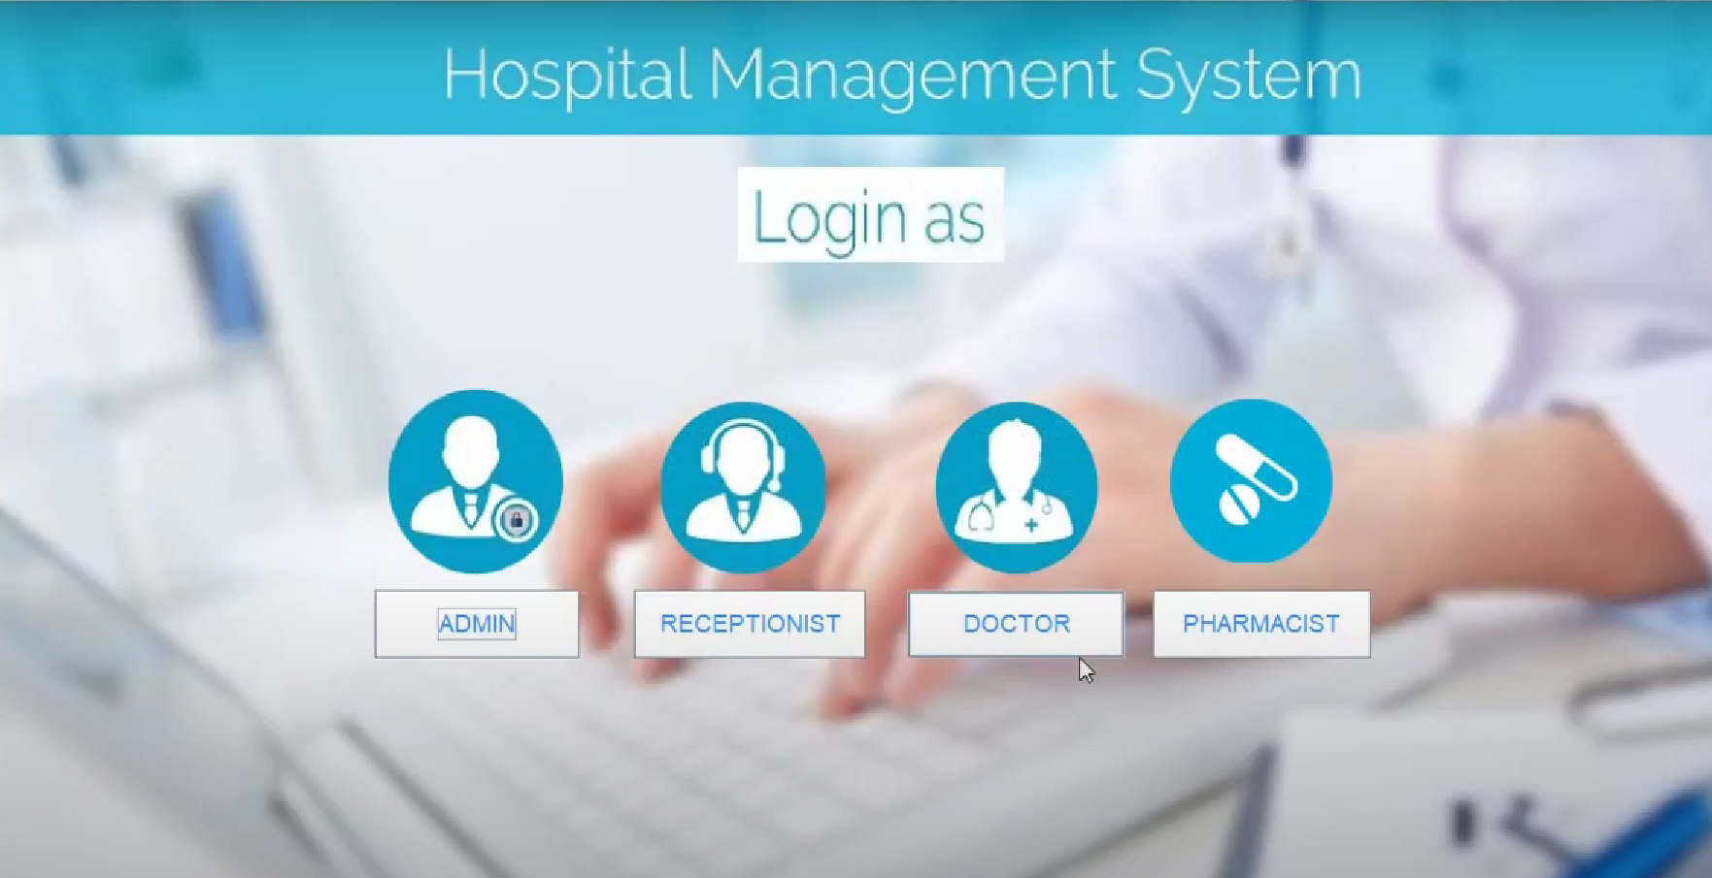
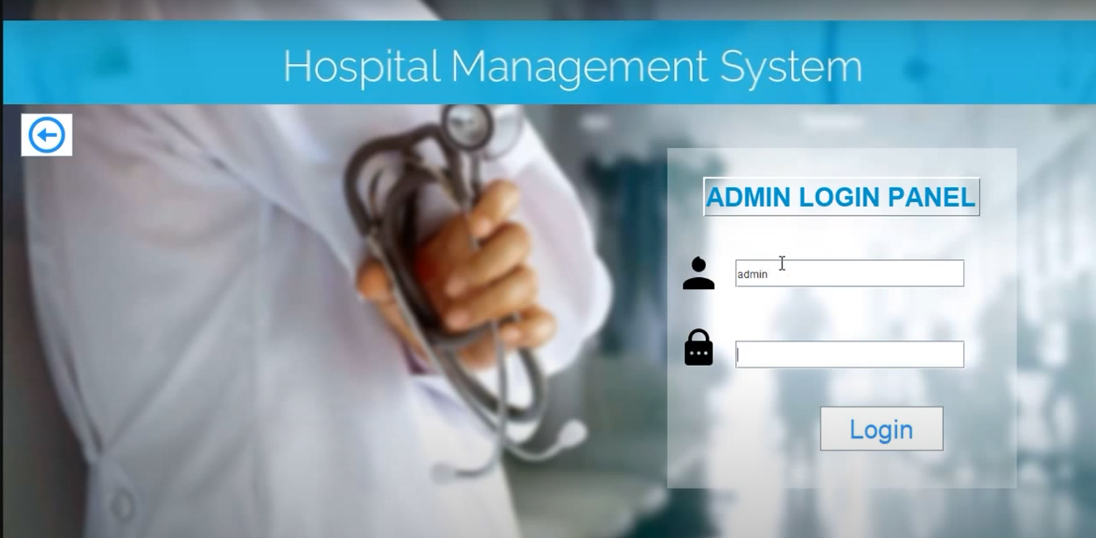
1. INDEX (starting page of HMS)
2. ADMIN LOGIN

Slide 4
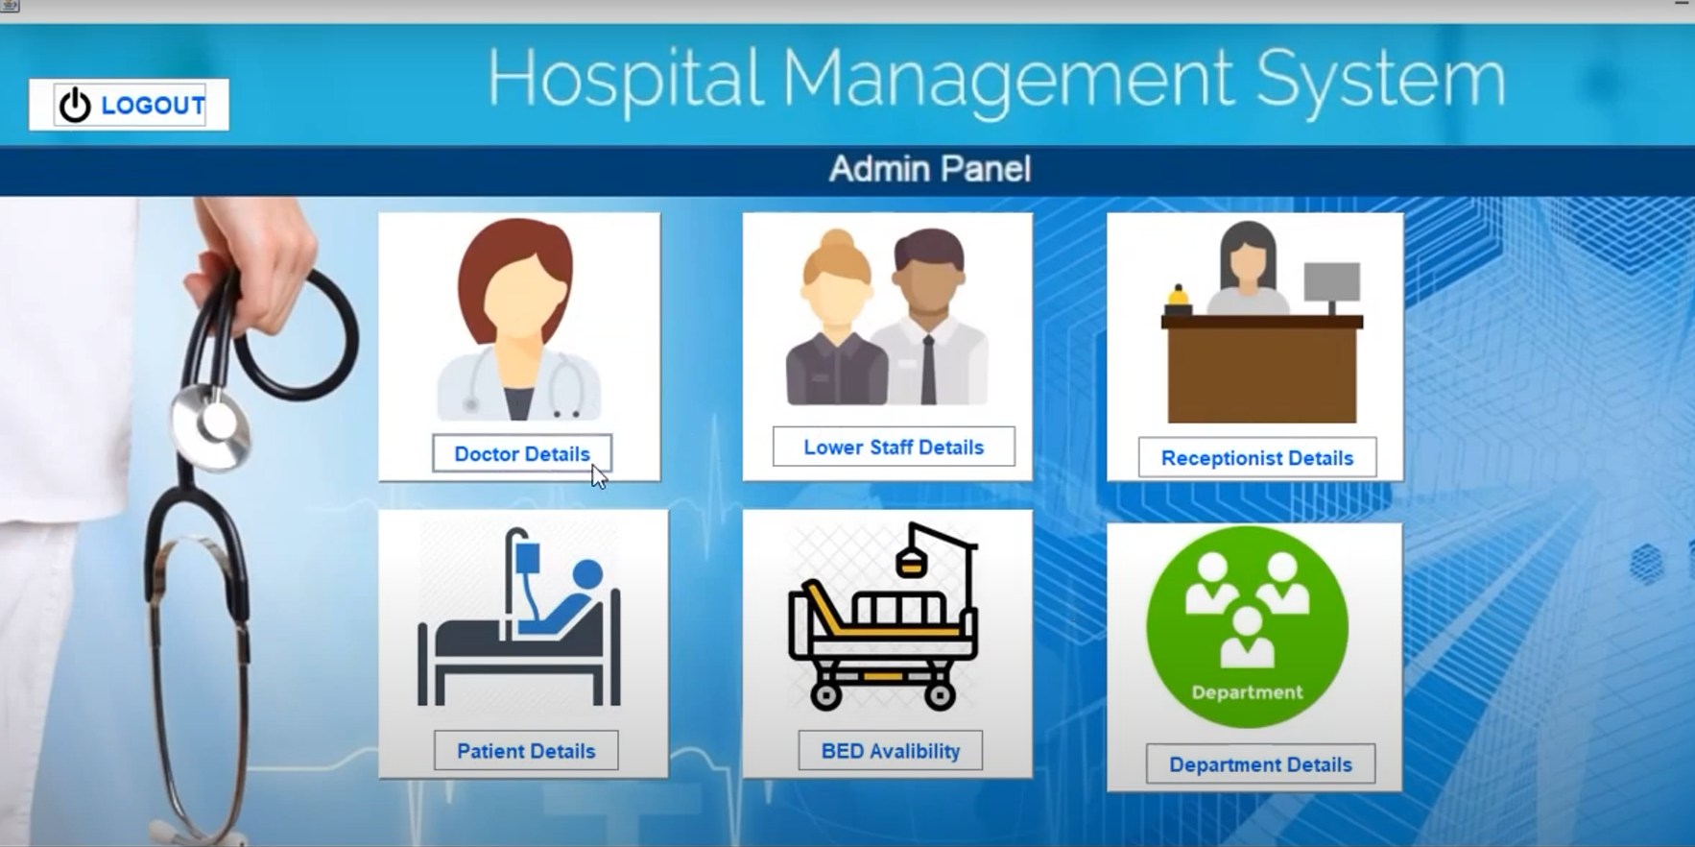
3. ADMIN PANEL (after the admin login this is the front page which has the all controls of the system through which admin can make the changes in the data of the system)

Slide 5
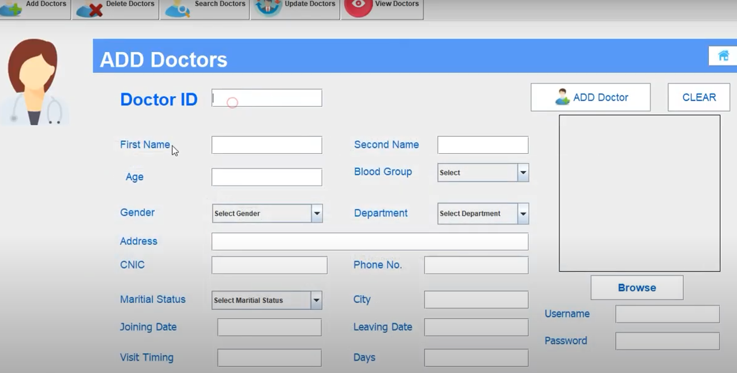
4. ADD DOCTOR
After the entry of admin to the admin panel as you can see there are a lot of changes that admin can do from these one of is
ADDING OF DOCTORS he can add details of appointed doctors and provide USERNAME AND PASSWORD
As you can see in the image above there are some more features are there as UPDATE , SEARCH , DELETE AND VIEW DOCTOR .
These can help in updating the details provided by the doctor on time to time , he can also fire a doctor by deleting ,searching also helpful and he can able to keep records and watch their details whenever he wants.

Slide 6
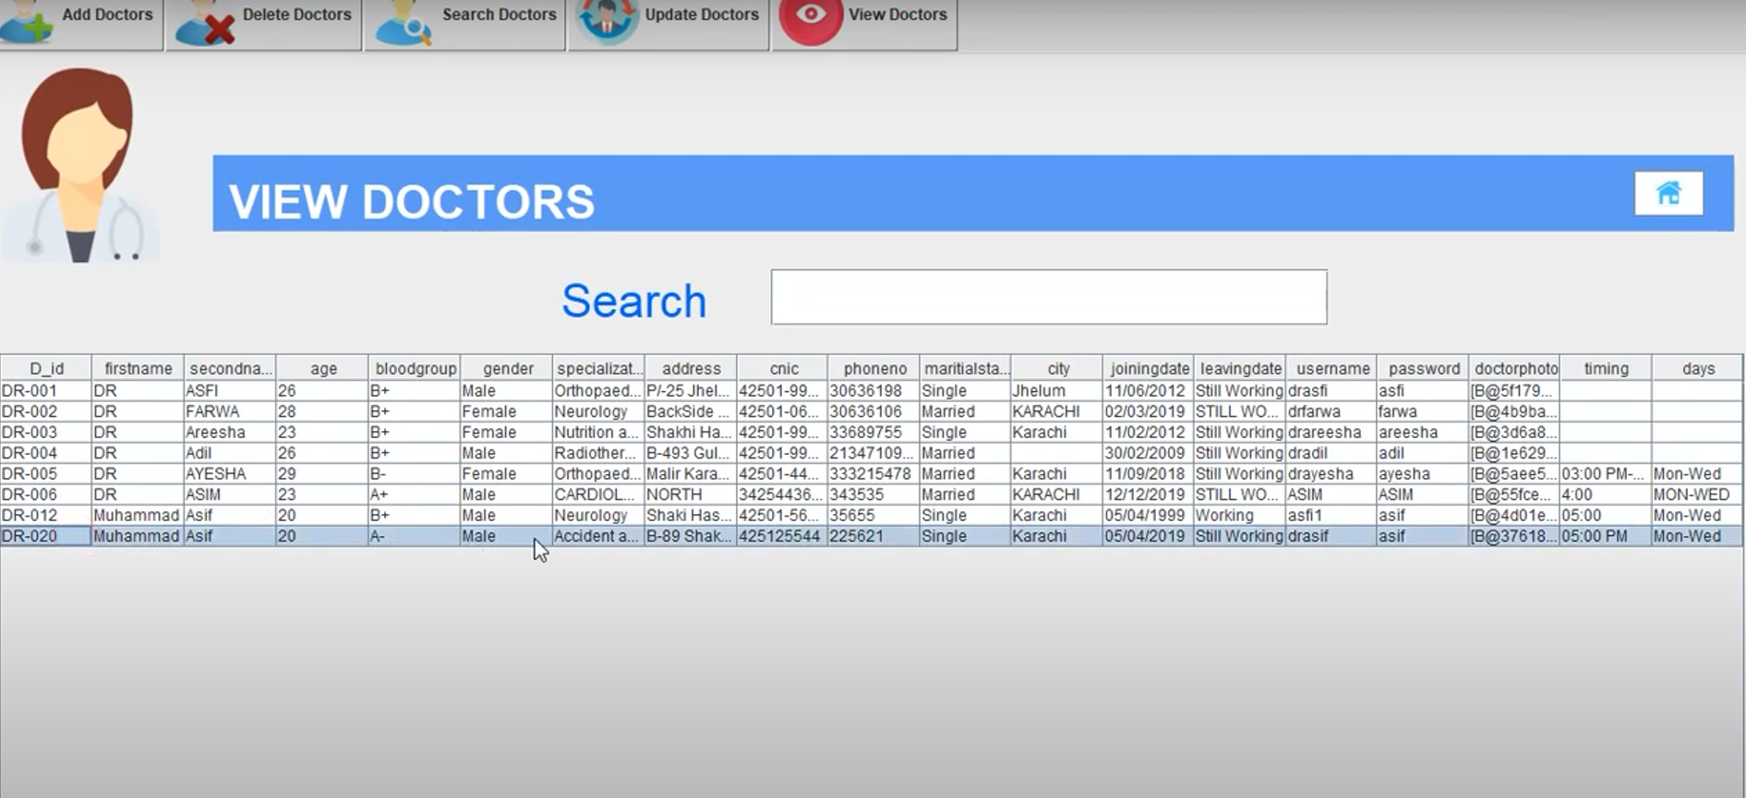
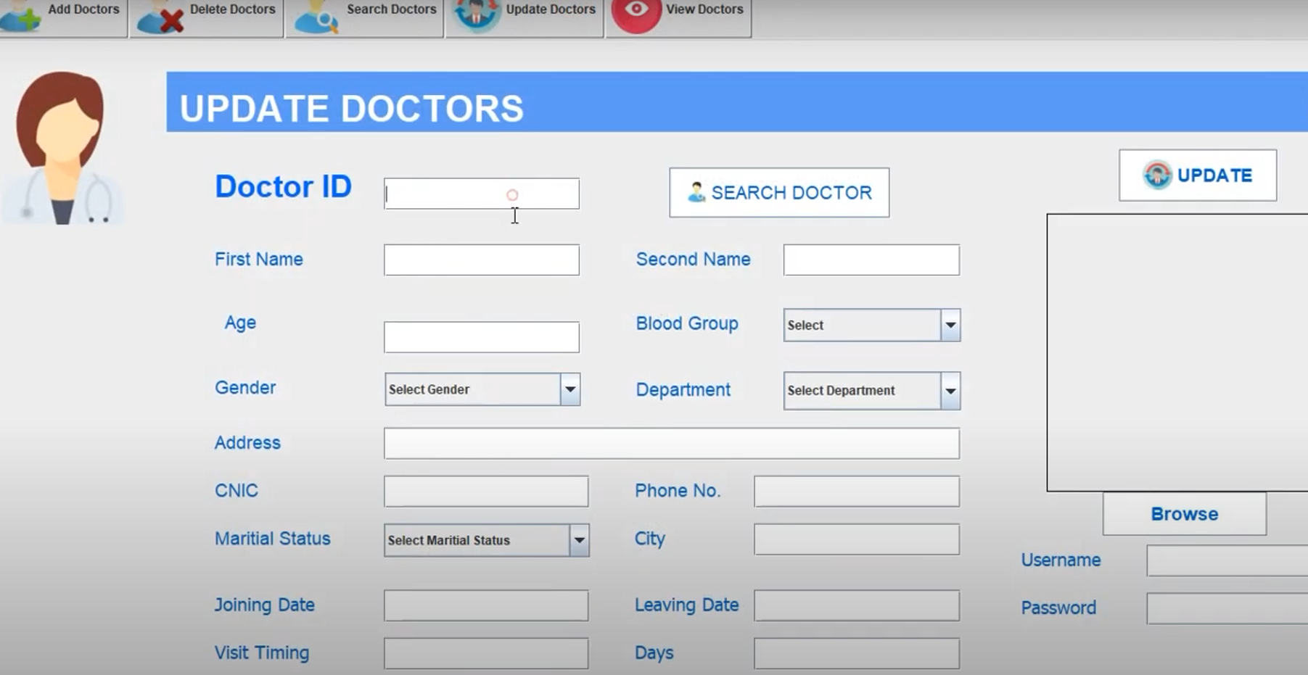
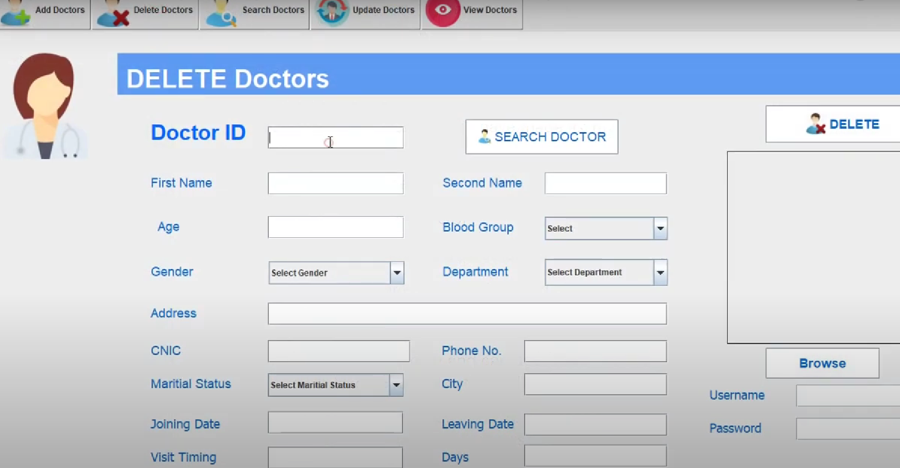

Slide 7
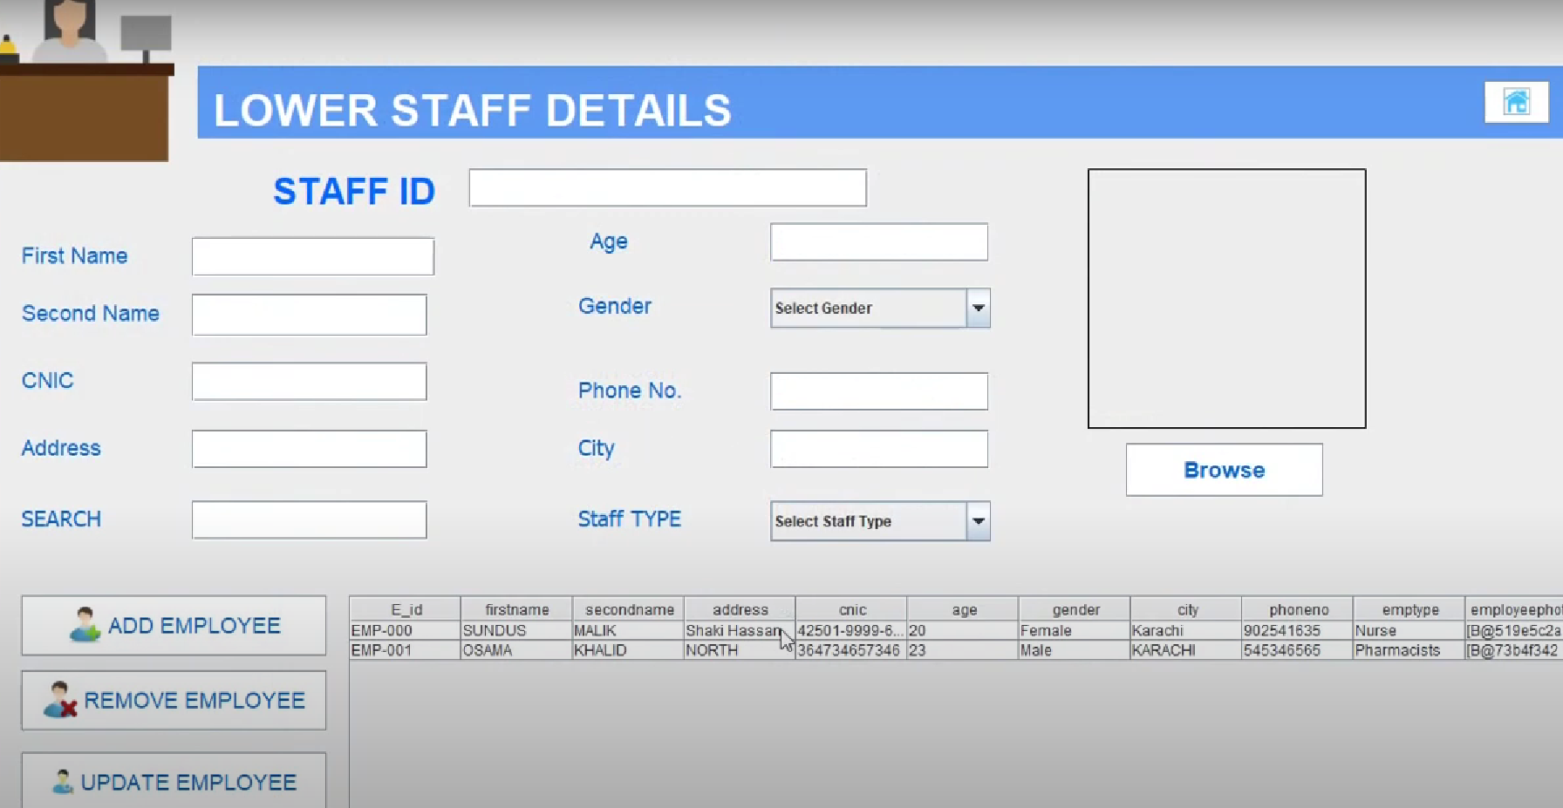
5. LOWER STAFF DETAILS
After doctor portal back to the admin panel ADMIN can also edit their employees or staff details as you can see in the given image .
as the employees does not have to work on computer interface then also their data will be recorded in the database
And as the connection is directly with the database ADMIN can update the details of employees , remove a employee and add many more employees to HMS

Slide 8
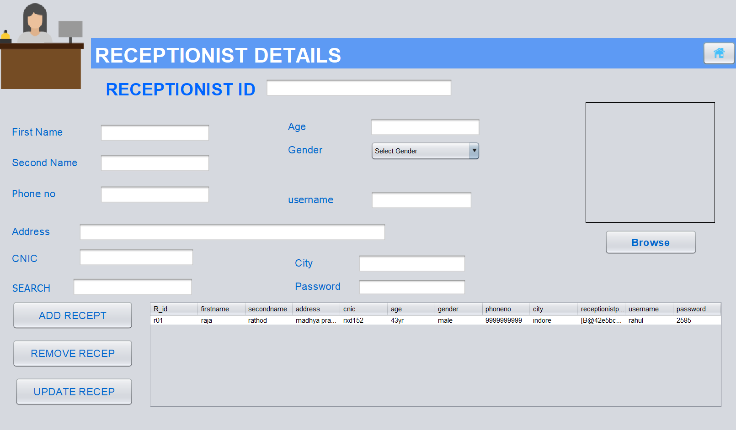
6. RECEPTION DETAILLS
Once again get back to the admin panel ADMIN can also edit the receptionist details as you can see in the given image .
as the receptionist will have to work on computer interface then also their data will be recorded in the database and they also have separate login system .
They can login with user credentials given by the admin , they can edit patient details and can able to make a appointment of a patient with a doctor ,,,,, I will share the screenshots below
And as the connection is directly with the database ADMIN can update the details of receptionist , remove a receptionist and add many more receptionist to HMS

Slide 9
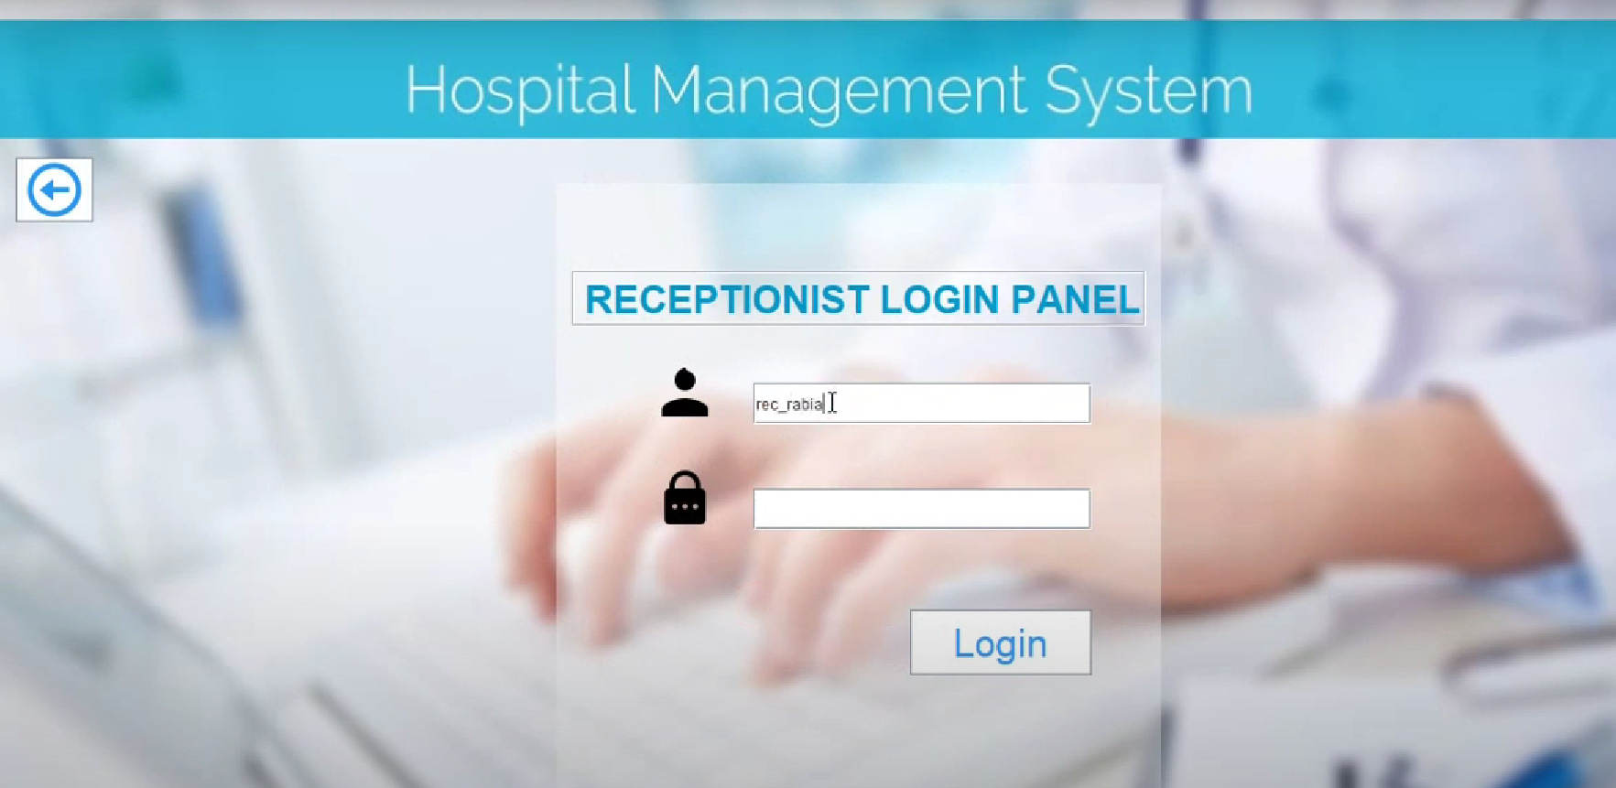
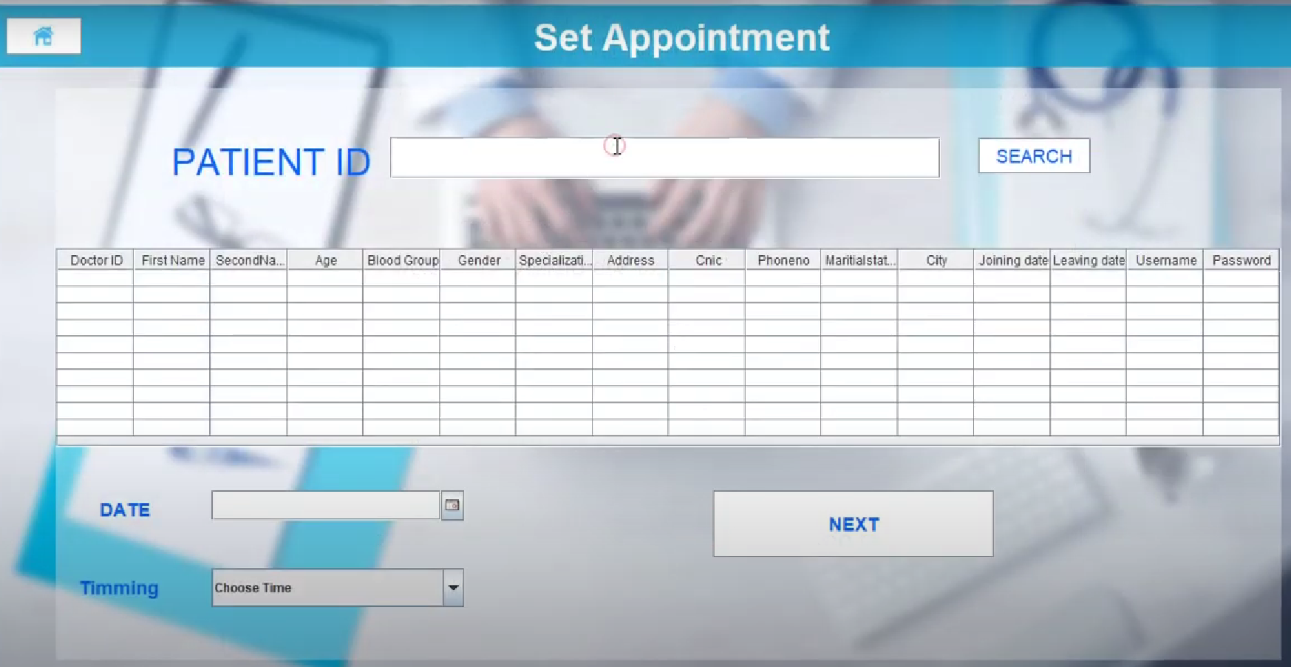
They can login with user credentials given by the admin , they can edit patient details and can able to make a appointment of a patient with a doctor

Slide 10
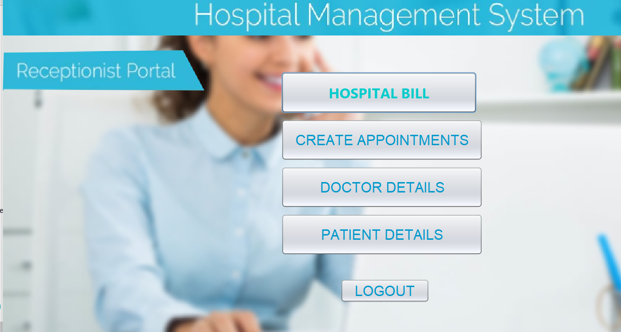
RECEPTIONIST LOGIN
AFTER THE LOGIN of receptionist they can see the interface given in image they can easily check the bed details , and make a appointment between doctor and patient and also they can calculate the hospital bill and generate it on system and print out after that which is saved in database if printer not connected.
Appointment page you can see in previous slide.

Slide 11
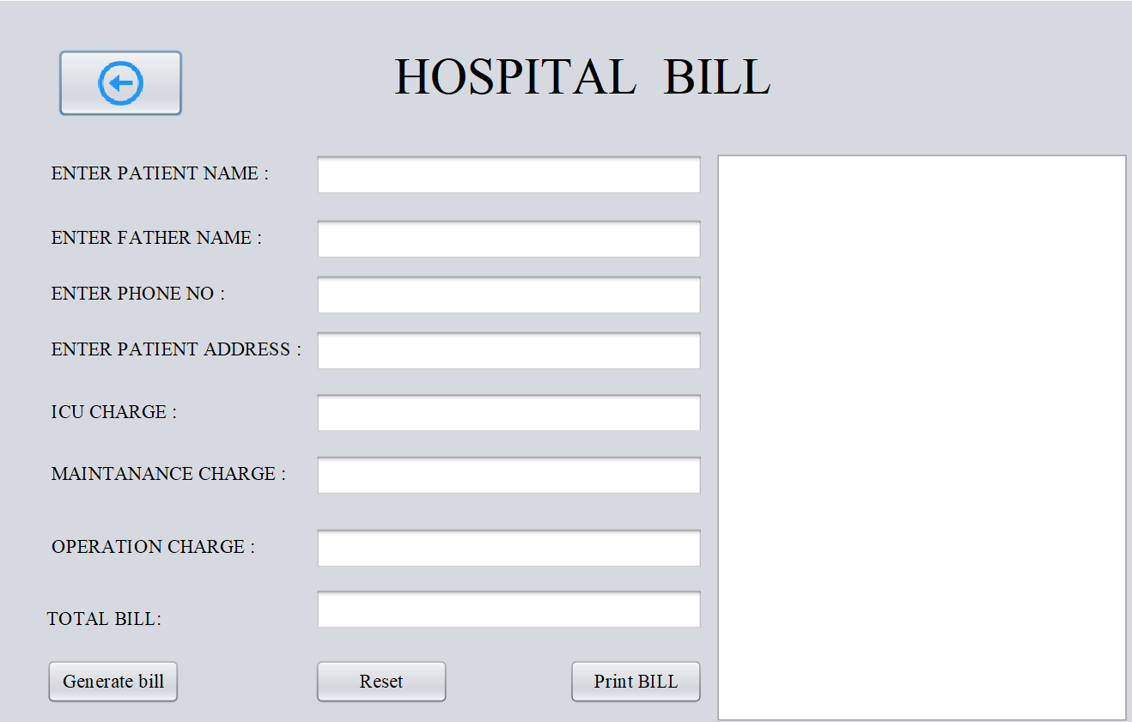
HOSPITAL BILL
As I said you first option in the last image is hospital bill
When we click it , it will open here and look like this here as you can see it has 3 options after the entries they are,
GENERATE BILL
RESET
PRINT BILL
First one as name suggest it will record the entries and represent on the bill
And the reset button will cancel the all entries and refreshes all the bars
The third one is when connected from outer printer it will print the bill otherwise saved in the system automatically

Slide 12
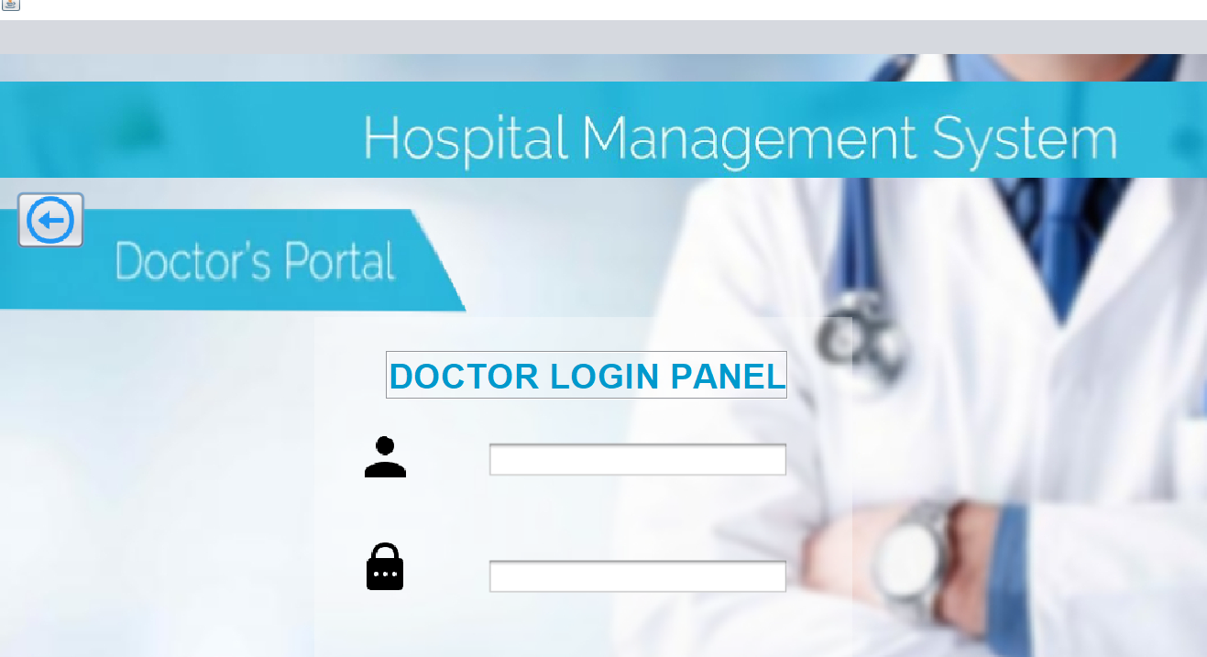
DOCTOR LOGIN
As the name itself suggest doctor can login from the credentials provided by admin doctor can login and he can able to see his appointments till date and able to see patient medical history.
As well as he can able to modify patient data and easily add patient directly to the database who visits him .
I will share the login page of doctor portel here and later on the doctor panel and so on ………..,,,,,,

Slide 13
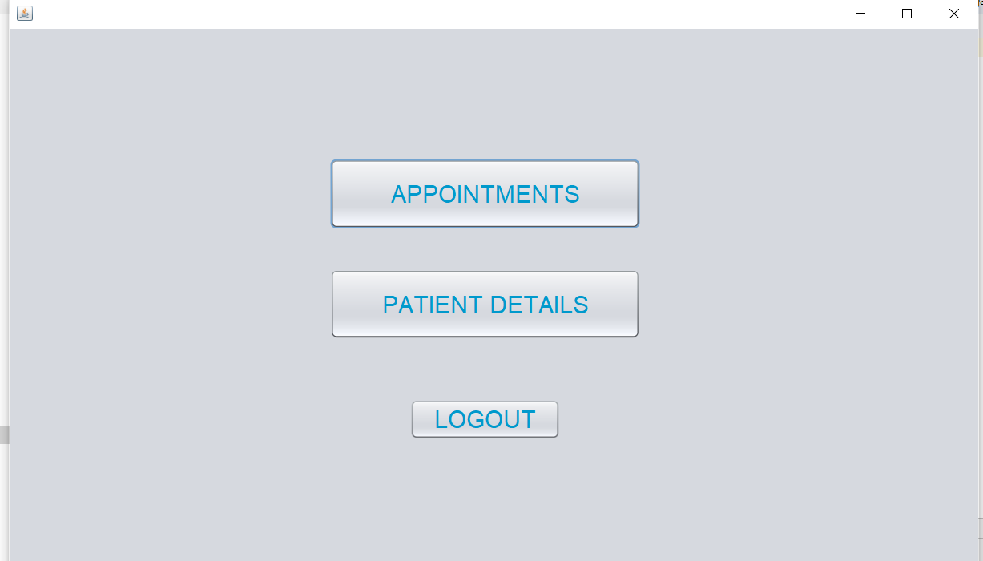
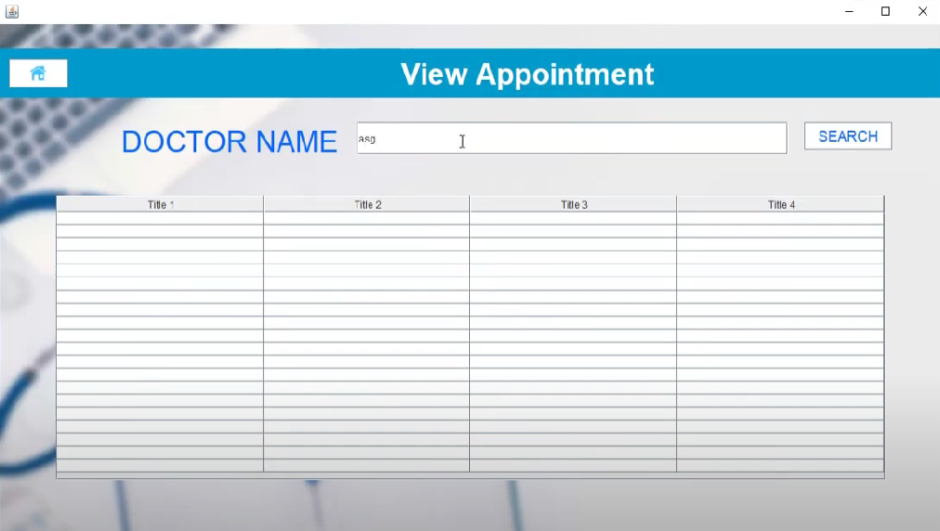
After clicking on appointment if he search with his name then all the appointment he can able to watch and manage his schedule and I am providing all the screenshots for your references below……….,

Slide 14
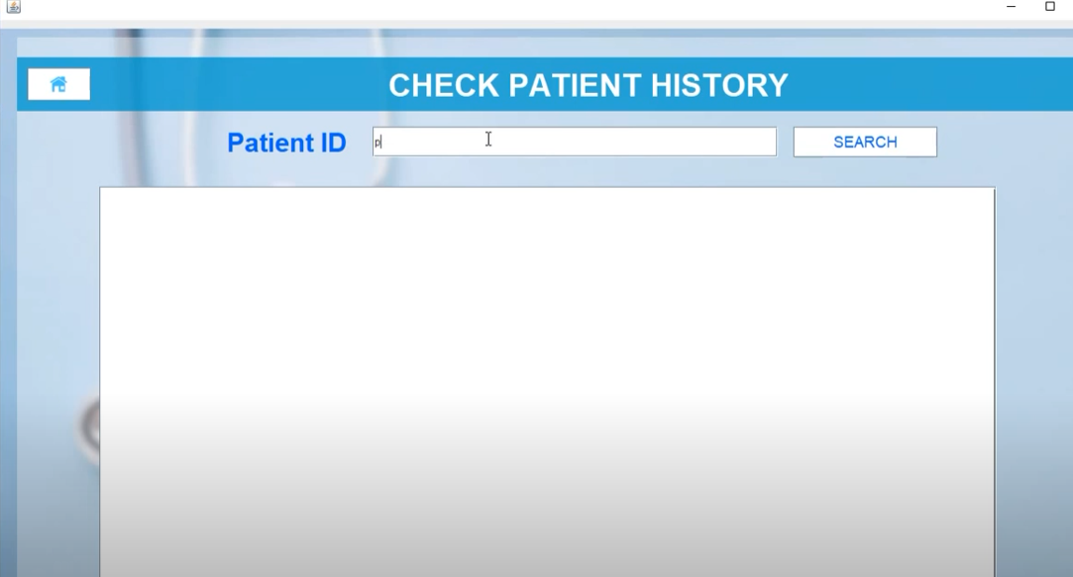
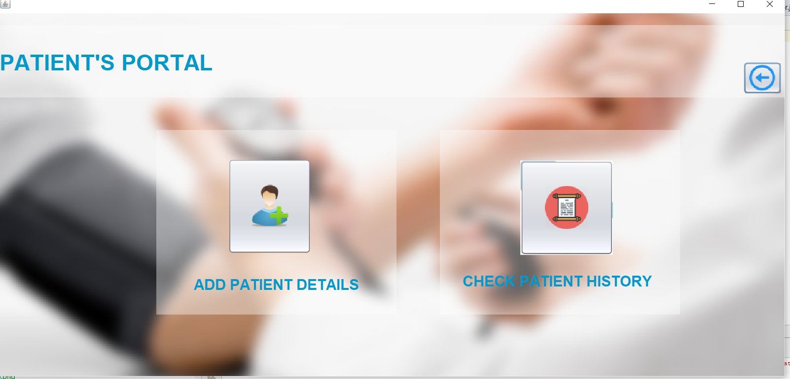
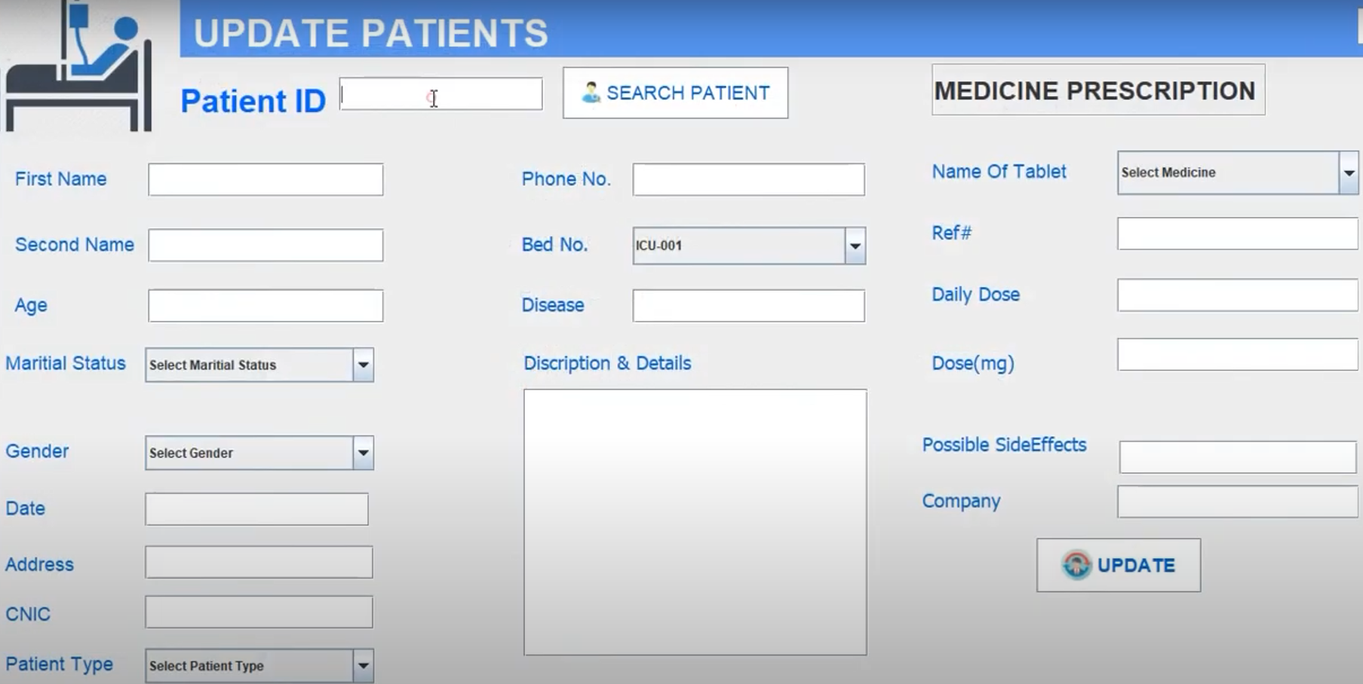

Slide 15
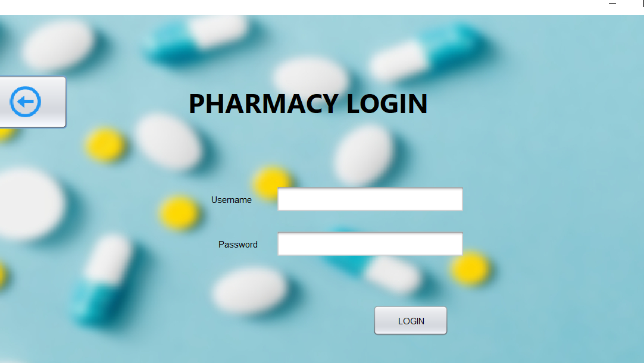
PHARMACY ;LOGIN
THE medicines provider of the hospital also has its login credentials with which he can login through the system and able to ADD , REMOVE AND ALSO HE UPDATA medicine details
I am –providing some module screen shots here , below you can see and one more thing the all the source images used are also provided here you can see it is my single handed project which I have tried with a lot of sleep less nights
AND BELOW YOU CAN SEE EER DIAGRAM OF A DATABASE TABLES

Slide 16
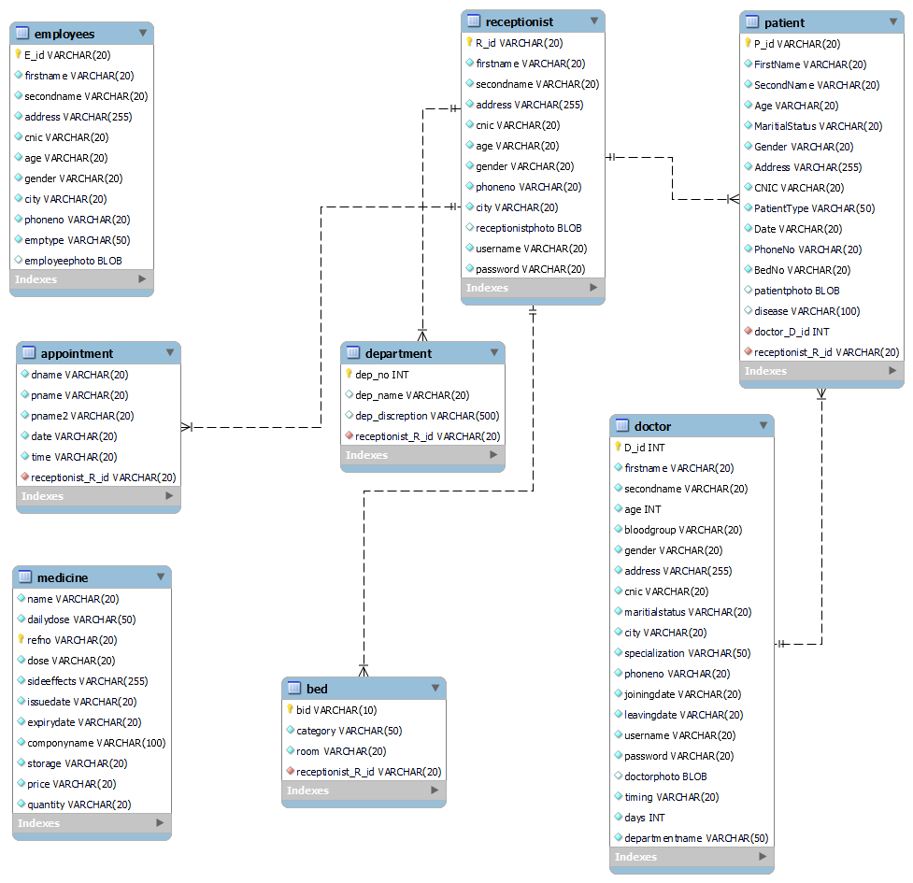
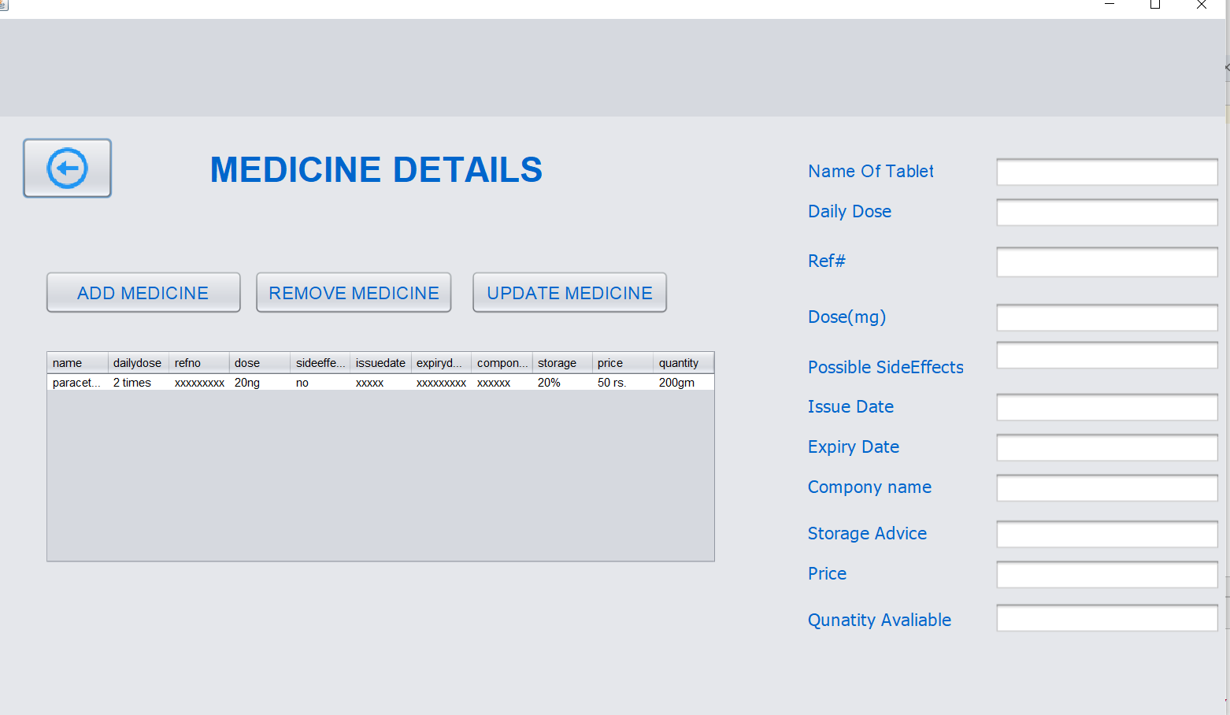
EER DIAGRAM OF HMS

Slide 17
LAST POINT
I have used only java and mysql and ,made a connection between these without intermediate and to use and run this you need some zar files which you can download and attach to this project
I am providing all the source code with this folder and this also present in this zip folder
For mysql code BACK END you need mysql workbench 8.0 cE
For front end apache netbeans 14 IDE

Slide 18
THANK YOU - Rahul Rathod

